Slide 1
Detector Physics
Ionization Detectors
GAPS Postdoc Lecture Series – October 26, 2015
D. Lascar | Postdoctoral Fellow | TRIUMF

Slide 2
Outline
Ionization Detectors
Behavior in the detector
Deposition of energy
Transport within the detector
Avalanche multiplication
Detector Types
Proportional counters
Multiwire Proportional Counters (MWPCs)
Gas Electron Multipliers (GEMs)
Limits

Slide 3
Gas a detector medium
Gas is pretty cheap.
E deposited in the form of electron-ion pairs.
You can take advantage of electric fields to perform charge separation.
You can make the detector portable.
Sensitivity is improved with advances in electronics.
Notes:
Bubble chambers and cloud chambers don’t count as ionization detectors. Also, they fell out of favor because they were primarily an optical medium => Advances in optical recognition software and digital photography could allow them to come back.

Slide 4
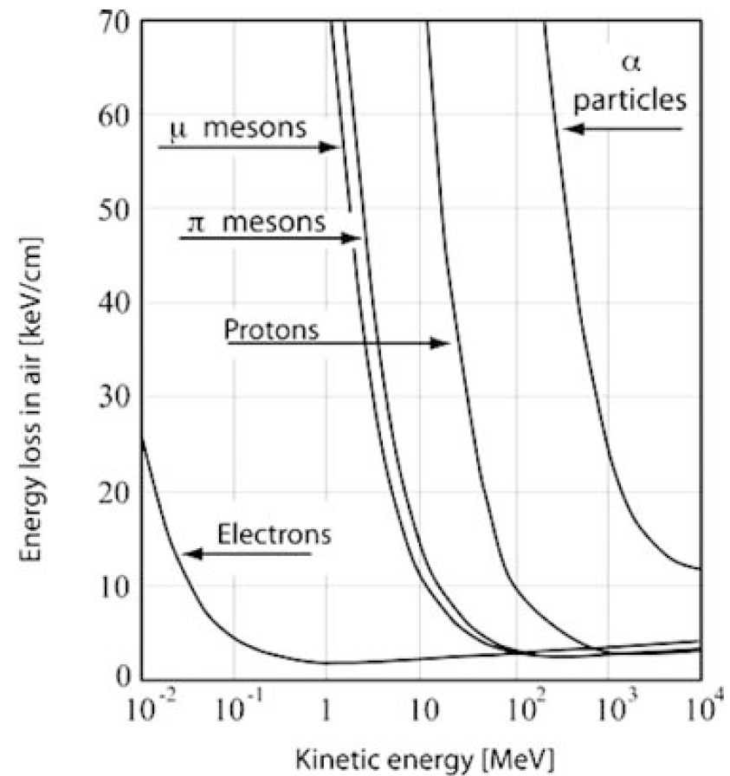
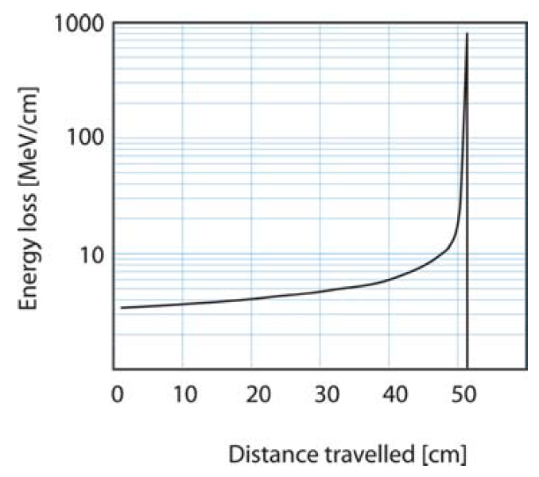
Charged particle energy loss – Due to e⁻
Bragg peak
Range: The distance a particle travels in medium before coming to rest
Electrons don’t have much mass
Notes:
Left – Energy loss in air as a function of particle KE
Calculated via Bethe Bloch formula
If density is in units of g/cm³ then E is in units of MeV
Right – 300 MeV proton in water
If E-loss decreases with increasing energy, it increases with decreasing energy

Slide 5
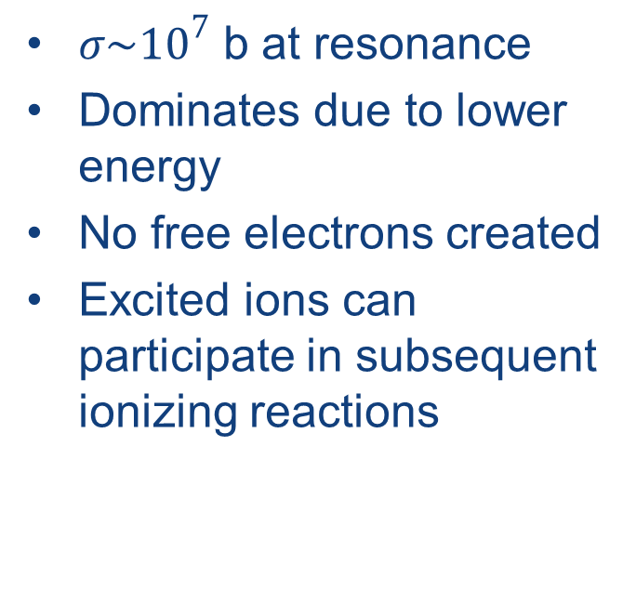
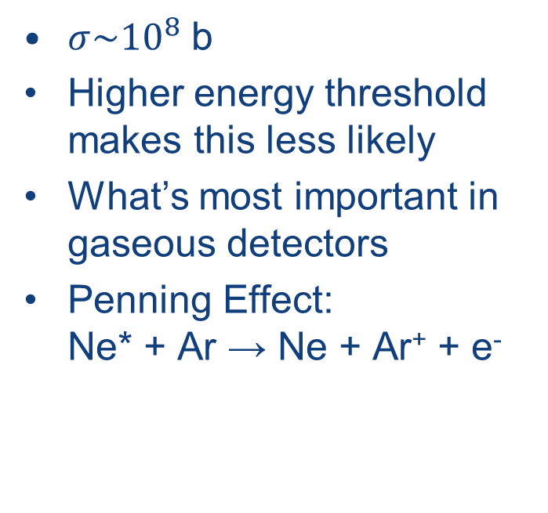
E loss due to e⁻: 2 types
Excitation X + p → X* + p
Ionization X + p → X⁺ + p + e⁻
$σ\sim {10}^{7}$ b at resonance
Dominates due to lower energy
No free electrons created
Excited ions can participate in subsequent ionizing reactions
$σ\sim {10}^{8}$ b
Higher energy threshold makes this less likely
What’s most important in gaseous detectors
Penning Effect: Ne* + Ar → Ne + Ar⁺ + e⁻

Slide 6
Charged particles with molecules
PRIMARY IONIZATION: ELECTRON-ION PAIRS
Minimum ionizing particles:
GAS (STP)
Helium
Argon
Xenon
CH
4
DME
dE/
dx
(
keV
/
cm
)
0.32
2.4
6.7
1.5
3.9
n
(ion pairs/
cm
)
6
25
44
16
55
Statistics of primary ionization:
Poisson:
=
n
k
−
n: average
k: actual number
P
n
e
n
k
k
!
(Maximum) detection efficiency:
ε
=
1
−
e
−
n
GAS (STP)
thickness
ε (%)
Helium
1
mm
45
2
mm
70
Slide courtesy of F. Sauli IEEE-NSS 2002
Argon
1
mm
91.8
2
mm
99.3
Notes:
E_{ionization} = 10-20 eV but what is required is typically 2x that.

Slide 7
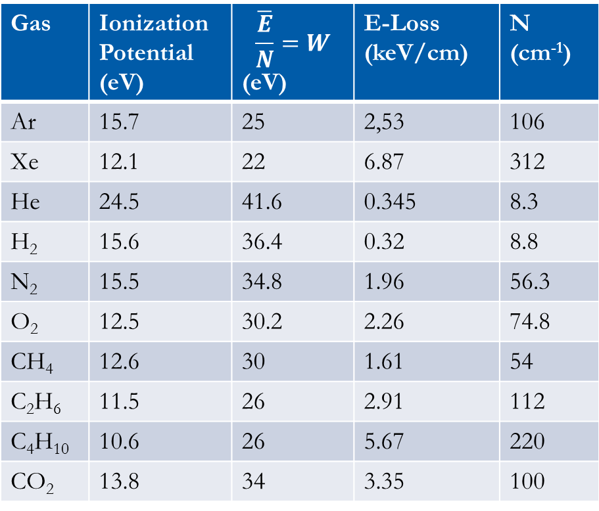
Secondary & total ionization
SECONDARY AND TOTAL IONIZATION
CLUSTERS & δ ELECTRONS:
Gas | Ionization Potential (eV) | $$\frac{\overline{E}}{N}=W$$ (eV) | E-Loss (keV/cm) | N (cm⁻¹)
Ar | 15.7 | 25 | 2,53 | 106
Xe | 12.1 | 22 | 6.87 | 312
He | 24.5 | 41.6 | 0.345 | 8.3
H₂ | 15.6 | 36.4 | 0.32 | 8.8
N₂ | 15.5 | 34.8 | 1.96 | 56.3
O₂ | 12.5 | 30.2 | 2.26 | 74.8
CH₄ | 12.6 | 30 | 1.61 | 54
C₂H₆ | 11.5 | 26 | 2.91 | 112
C₄H₁₀ | 10.6 | 26 | 5.67 | 220
CO₂ | 13.8 | 34 | 3.35 | 100
Statistical nature of ionization means W not strongly dependent on particle type or gas
Notes:
Whenever an electron has enough energy to ionize another atom, the resultant free electrons are called secondary electrons or δ-electrons
Ionizing reactions are statistical in nature -> 2 identical particles won’t create the same number of E-I pairs
W = Mean energy/electron pair -> Not equal to Energy/ionization energy because excitation often happens

Slide 8
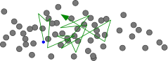
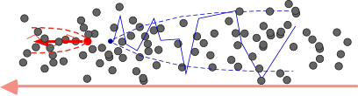
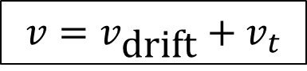
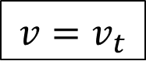
DRIFT
DRIFT AND DIFFUSION OF CHARGES IN GASES
ELECTRIC FIELD E = 0: THERMAL DIFFUSION
$${v=v}_{t}$$
ELECTRIC FIELD E > 0: CHARGE TRANSPORT AND DIFFUSION
$$v={v_{\text{drift}}+v}_{t}$$
IONS
ELECTRONS
E
Notes:
V_{t} = thermal velocity
Without an E-field, the motion is a pure random walk.
With an E-field, the motion is interrupted by collisions but is overall in a single direction.

Slide 9
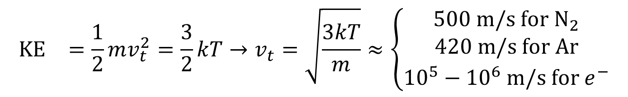

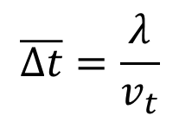
Can we derive $v_{\text{drift}}$?
$${\text{KE}}_{}=\frac{1}{2}mv_{t}^{2}=\frac{3}{2}kT→v_{t}=\sqrt{\frac{3kT}{m}}≈\left\{\begin{matrix}500 \text{m}\text{/}\text{s} \text{for} {\text{N}}_{2} \\ 420 \text{m}\text{/}\text{s} \text{for} \text{Ar} \\ {10}^{5}−{10}^{6} \text{m}\text{/}\text{s} \text{for} e^{−}\end{matrix}\right.$$
$$\overline{Δt}=\frac{λ}{v_{t}}$$
Mean free path
Average time between collisions

Slide 10
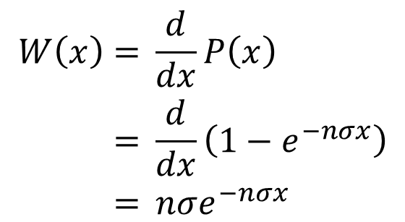
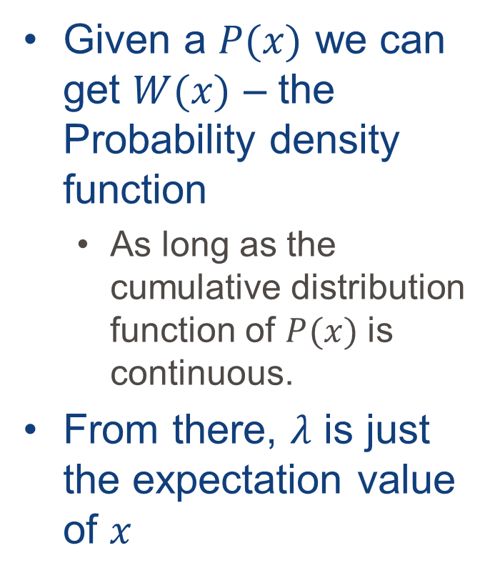
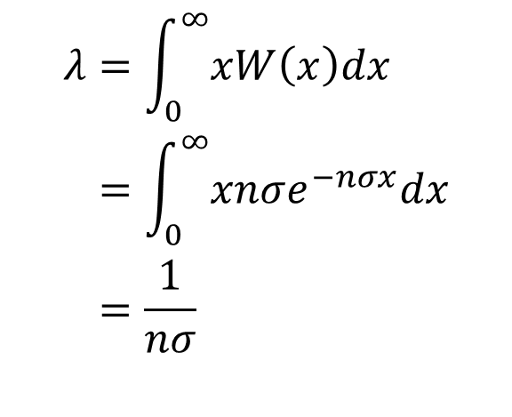
Mean free path - λ
Given a $P(x)$ we can get $W(x)$ – the Probability density function
As long as the cumulative distribution function of $P(x)$ is continuous.
From there, $λ$ is just the expectation value of $x$
$$\begin{aligned}W\left(x\right)&=&&\frac{d}{dx}P\left(x\right) \\ &=&&\frac{d}{dx}\left(1−e^{−nσx}\right) \\ &=&&nσe^{−nσx}\end{aligned}$$
$$\begin{aligned}λ&=&&\int_{0}^{∞}{xW\left(x\right)dx} \\ &=&&\int_{0}^{∞}{xnσe^{−nσx}dx} \\ &=&&\frac{1}{nσ}\end{aligned}$$

Slide 11
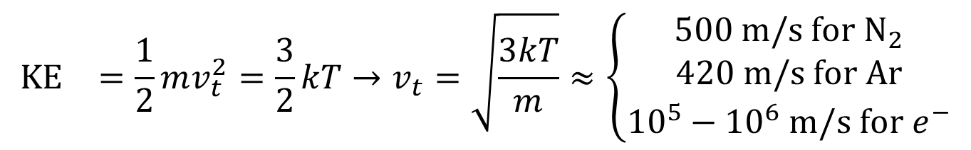
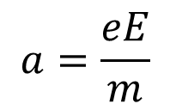
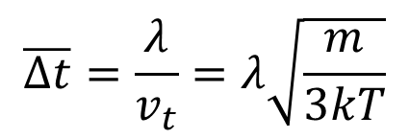
Can we derive $v_{\text{drift}}$?
$${\text{KE}}_{}=\frac{1}{2}mv_{t}^{2}=\frac{3}{2}kT→v_{t}=\sqrt{\frac{3kT}{m}}≈\left\{\begin{matrix}500 \text{m}\text{/}\text{s} \text{for} {\text{N}}_{2} \\ 420 \text{m}\text{/}\text{s} \text{for} \text{Ar} \\ {10}^{5}−{10}^{6} \text{m}\text{/}\text{s} \text{for} e^{−}\end{matrix}\right.$$
$$\overline{Δt}=\frac{λ}{v_{t}}=λ\sqrt{\frac{m}{3kT}}$$
$$a=\frac{eE}{m}$$
Electric field

Slide 12
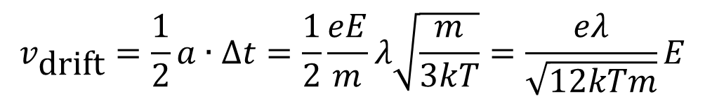
Can we derive $v_{\text{drift}}$?
$${\text{KE}}_{}=\frac{1}{2}mv_{t}^{2}=\frac{3}{2}kT→v_{t}=\sqrt{\frac{3kT}{m}}≈\left\{\begin{matrix}500 \text{m}\text{/}\text{s} \text{for} {\text{N}}_{2} \\ 420 \text{m}\text{/}\text{s} \text{for} \text{Ar} \\ {10}^{5}−{10}^{6} \text{m}\text{/}\text{s} \text{for} e^{−}\end{matrix}\right.$$
$$\overline{Δt}=\frac{λ}{v_{t}}=λ\sqrt{\frac{m}{3kT}}$$
$$a=\frac{eE}{m}$$
$$v_{\text{drift}}=\frac{1}{2}a∙Δt=\frac{1}{2}\frac{eE}{m}λ\sqrt{\frac{m}{3kT}}=\frac{eλ}{\sqrt{12kTm}}E$$
Ion Mobility
μ
Notes:
This is for ions

Slide 13
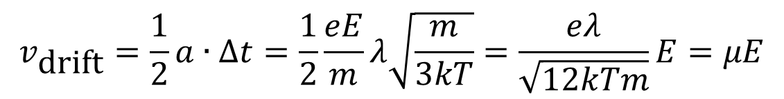
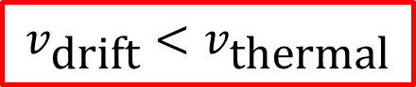
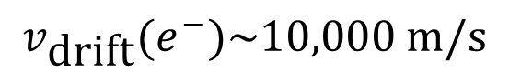
Can we derive $v_{\text{drift}}$?
$${\text{KE}}_{}=\frac{1}{2}mv_{t}^{2}=\frac{3}{2}kT→v_{t}=\sqrt{\frac{3kT}{m}}≈\left\{\begin{matrix}500 \text{m}\text{/}\text{s} \text{for} {\text{N}}_{2} \\ 420 \text{m}\text{/}\text{s} \text{for} \text{Ar} \\ {10}^{5}−{10}^{6} \text{m}\text{/}\text{s} \text{for} e^{−}\end{matrix}\right.$$
$$\overline{Δt}=\frac{λ}{v_{t}}=λ\sqrt{\frac{m}{3kT}}$$
$$a=\frac{eE}{m}$$
$$v_{\text{drift}}=\frac{1}{2}a∙Δt=\frac{1}{2}\frac{eE}{m}λ\sqrt{\frac{m}{3kT}}=\frac{eλ}{\sqrt{12kTm}}E=μE$$
Given a drift field of 1 kV/cm:
$$v_{\text{drift}}\left({\text{N}}_{2}\right)=34 \text{m}\text{/}\text{s}$$
$$v_{\text{drift}}(e^{−})\sim 10,000 \text{m}\text{/}\text{s}$$
$$v_{\text{drift}}<v_{\text{thermal}}$$
Notes:
This is for ions

Slide 14
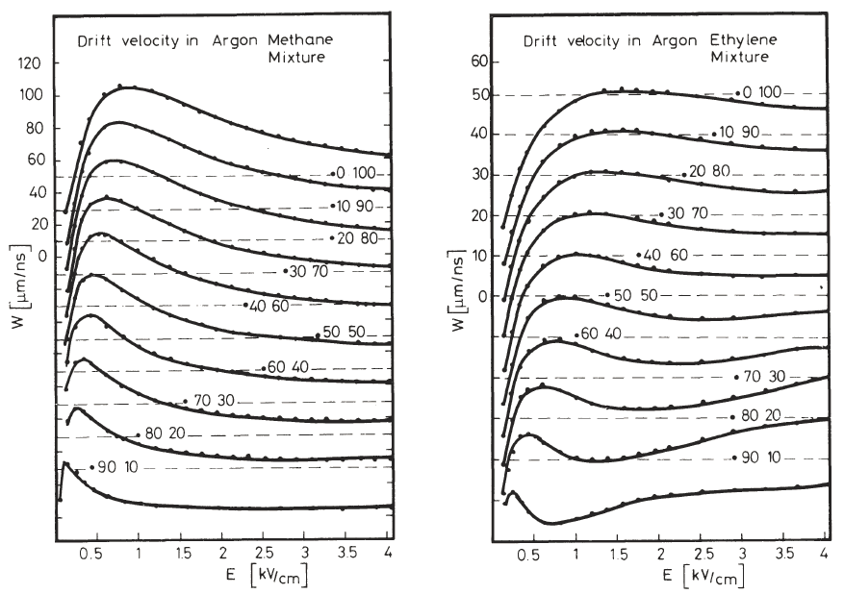
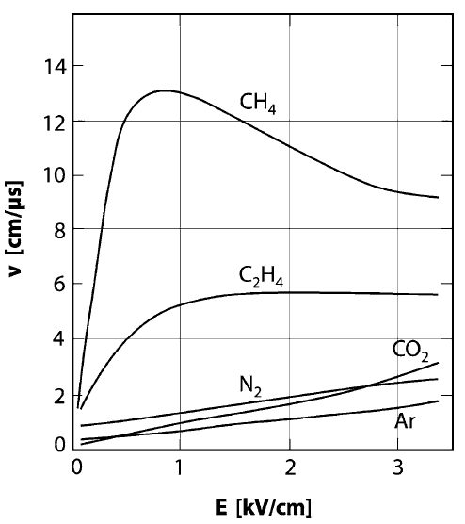
Gas mixture matters
Notes:
This is for electrons
1 μm/ns = 1 km/s

Slide 15
What is going on in the gas?
After recombination, Ar emits photon
High prob. of e⁻ from cathode
During recombination, collision with cathode likely emits more than 1 e⁻
Enough extra e⁻ could cause a discharge
Ar
Metals
Notes:
Ar first ionization potential is 11.6 eV

Slide 16
What is going on in the gas?
After recombination, Ar emits photon
High prob. of e⁻ from cathode
During recombination, collision with cathode likely emits more than 1 e⁻
Enough extra e⁻ could cause a discharge
Introduce polyatomic quenching gas (hydrocarbon).
CH₄ (Methane)
C₄H₁₀ (Isobutane)
Many rotational & vibrational degrees of freedom
Absorbs photons
Charge exchange with Ar⁺ ions
Notes:
When the quenching molecule reaches the cathode, charge exchange much less likely to emit secondary electrons.

Slide 17
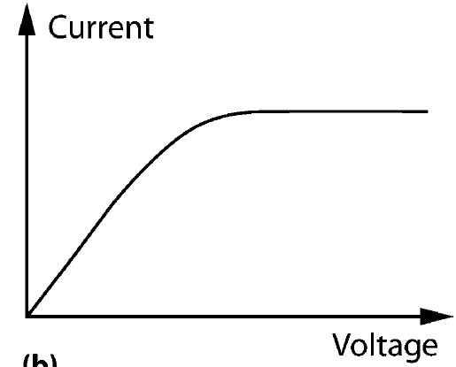
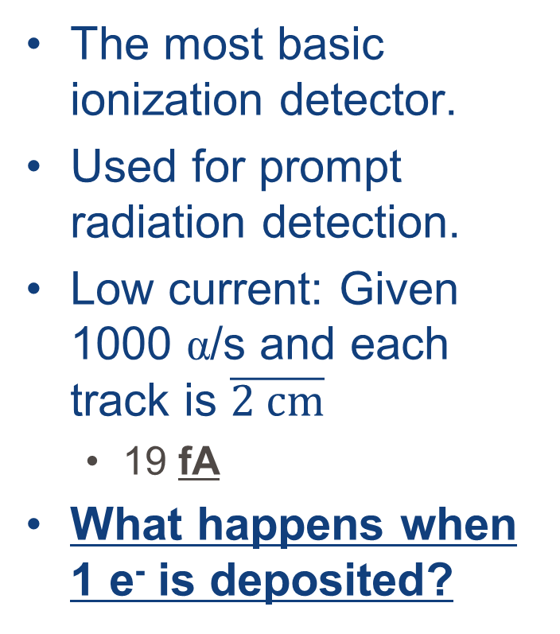
Ionization chamber
The most basic ionization detector.
Used for prompt radiation detection.
Low current: Given 1000 α/s and each track is $\overline{2 \text{cm}}$
19 fA
What happens when 1 e⁻ is deposited?
i
ΔV
Notes:
As voltage increases, the amount of electrons that make it to the anode approach 100%
Some smoke detectors measure ionization currents in air generated by Americium-241

Slide 18
Challenge:
i
ΔV
Single electrons are hard to detect. What to do?
Stronger Field
Gives electrons more energy
If the electrons have enough energy to ionize along their path
Constant E-field so avalanche everywhere
PPAC
arallel
late
valanche
ounter
Notes:
PPAC gives position sensitivity at the cost of charge/energy deposition knowledge
Ask where it would be useful. Onsite?
Before going to next slide, “So we have a medium where charge is deposited and a means of amplifying the charge, can we control it to get both position and energy?

Slide 19
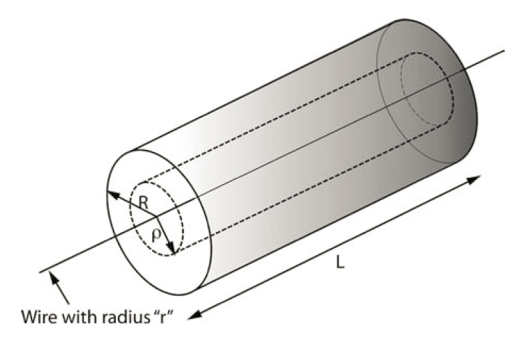
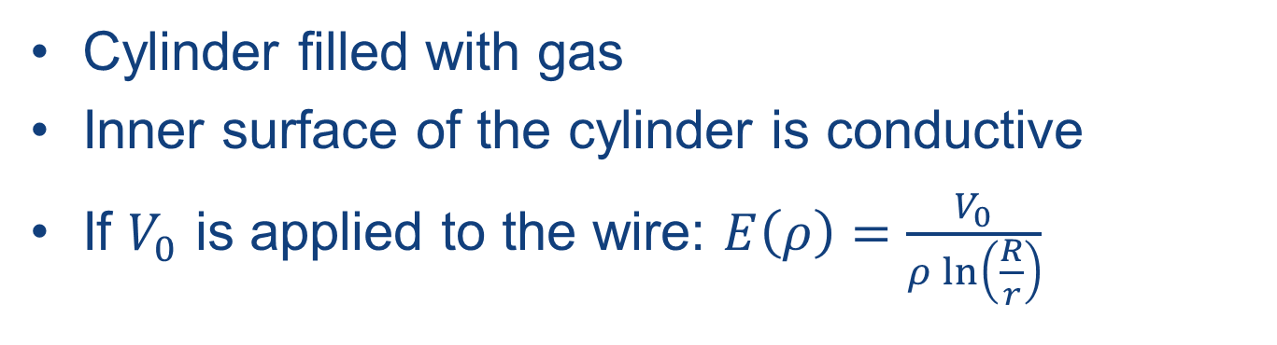
The Geiger-Müller tube
Cylinder filled with gas
Inner surface of the cylinder is conductive
If $V_{0}$ is applied to the wire: $E\left(ρ\right)=\frac{V_{0}}{ρ\ln\left(\frac{R}{r}\right)}$

Slide 20
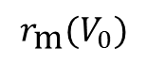
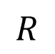
The Geiger-Müller tube
Drift Region
$$r_{\text{m}}(V_{0})$$
$$R$$
Multiplication Region

Slide 21
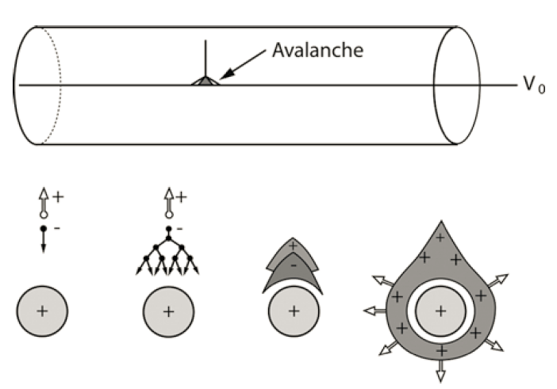
The Geiger-Müller tube

Slide 22
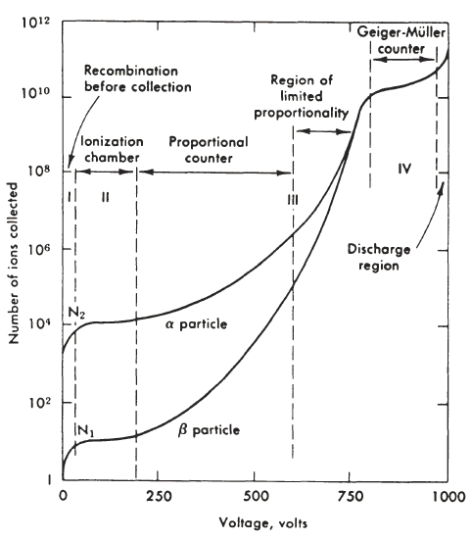
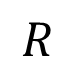
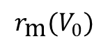
The Geiger-Müller tube
$$r_{\text{m}}(V_{0})$$
$$R$$
Notes:
Go through each region as V₀ increases.

Slide 23
The Geiger-Müller tube
What you gain:
Energy sensitivity that is scalable with voltage
Position sensitivity in x or y
Portability
What you lose:
Position sensitivity in x and y or
Money – get position back with an array.

Slide 24
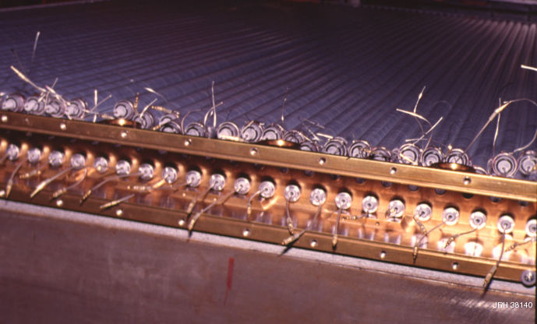
Proportional Tube Array
Photo courtesy of J.R. Hörandel http://particle.astro.ru.nl/etracersetup.html
Notes:
You take advantage of the fact that the energy deposited in each tube won’t be 100%
This was part of the TRACER balloon project.
This layer had
2 m long tubes.
2 cm I.D.
Walls made of aluminized mylar
Instrument made of 8 layers (4x and 4y)

Slide 25
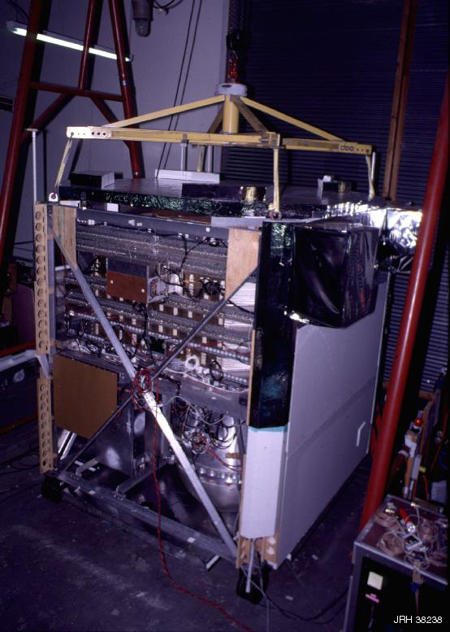
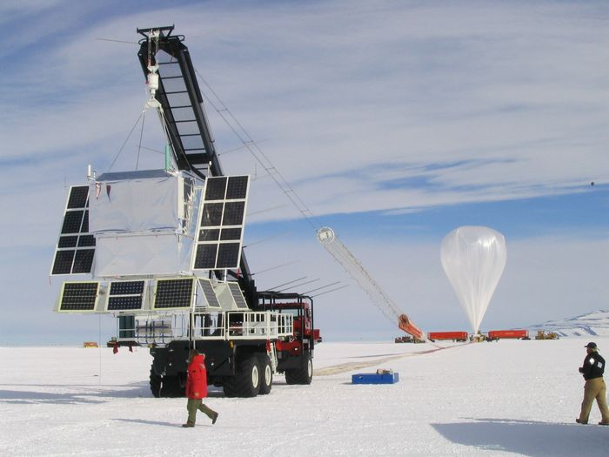
TRACER
Photo courtesy of stratocat.com
Photo courtesy of J.R. Hörandel http://particle.astro.ru.nl/etracersetup.html
Notes:
More than 2000 tubes were built -> Labor intensive.
What if I don’t want to do this over a large area?

Slide 26
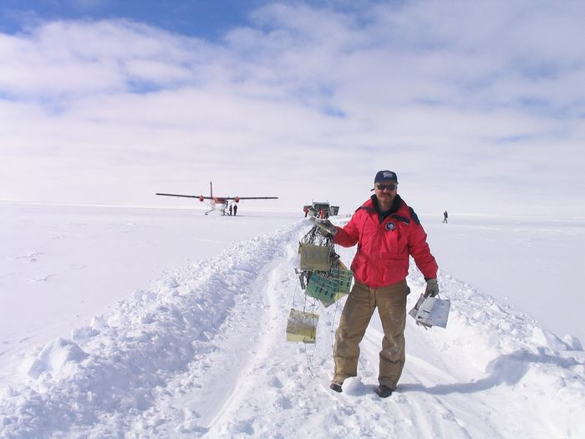
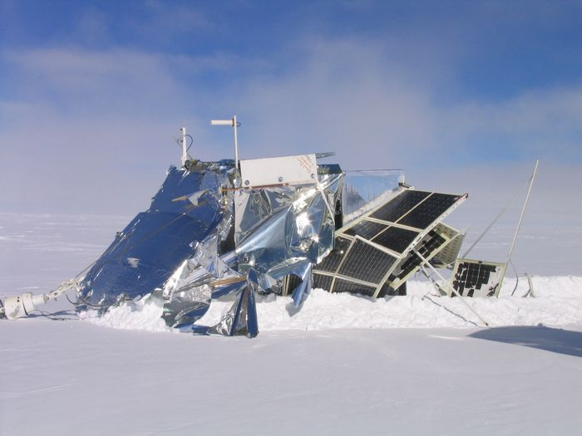
TRACER
Photo courtesy of stratocat.com
Photo courtesy of stratocat.com
Notes:
At the end of the flight the instrument detached from the balloon and parachuted to the ground
Upon landing, the instrument didn’t detach from the parachute so when the wind re-inflated the chute, the intrument was dragged for 6 miles

Slide 27
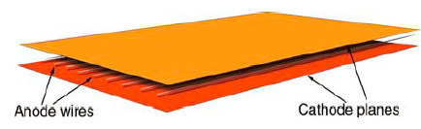
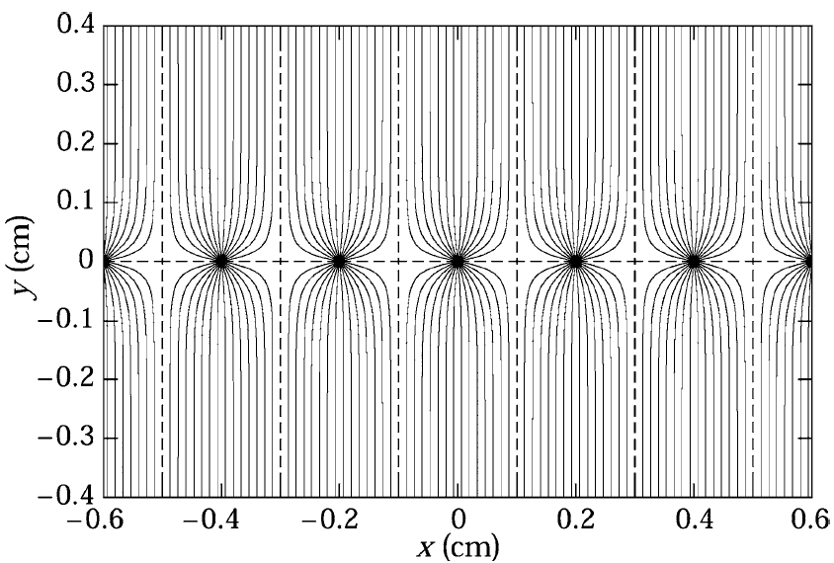
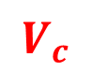

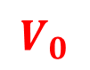
Multiwire Proportional Chamber (MWPC)
What if you don’t want a plethora of independent gas volumes?
Each wire acts as its own proportional counter.
Could snake the wire and use a delay line.
$$V_{c}$$
$$V_{0}$$
$$V_{c}$$
Notes:
Wires at V₀. Cathodes are at V_{c}

Slide 28
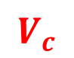



MWPC X-Y sensitivity
$$V_{c}$$
What if you want 2D sensitivity?
Create an array in X and an array in Y below.
Charge deposited above goes to the top array and
Signal induces an image charge on the opposite array
$$V_{0}$$
$$V_{0}$$
$$V_{c}$$

Slide 29
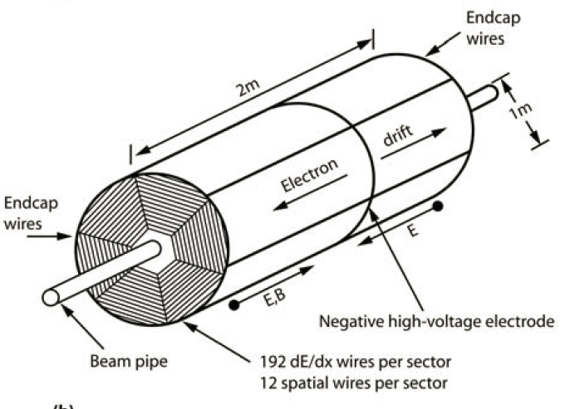
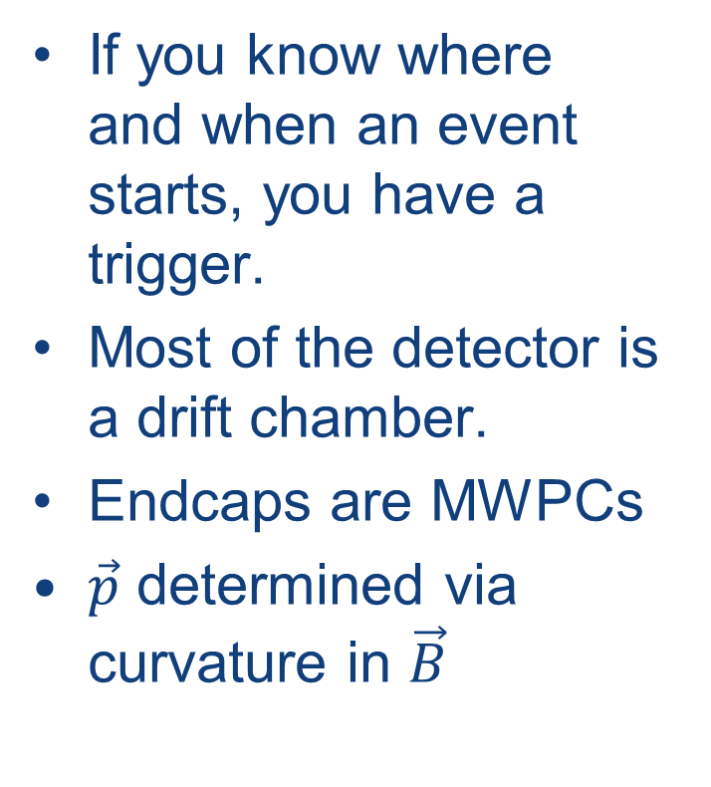
E.G. The Time Projection Chamber (TPC)
If you know where and when an event starts, you have a trigger.
Most of the detector is a drift chamber.
Endcaps are MWPCs
$\vec{p}$ determined via curvature in $\vec{B}$
Notes:
Go through the diagram. Start with the structure. Note the magnetic field direction.

Slide 30

TPC movie

Slide 31
What if you need more gain?
It’s still hard to detect low energy events.
Proportional tubes/MWPCs have only one stage of charge multiplication.
Proportional tubes arrays & MWPCs are labor-intensive to assemble.
What is needed is an array of discreet charge multiplication regions.

Slide 32
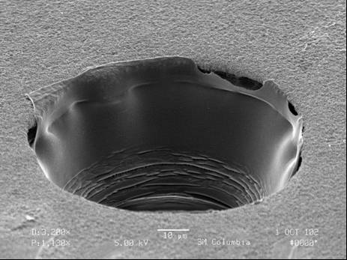
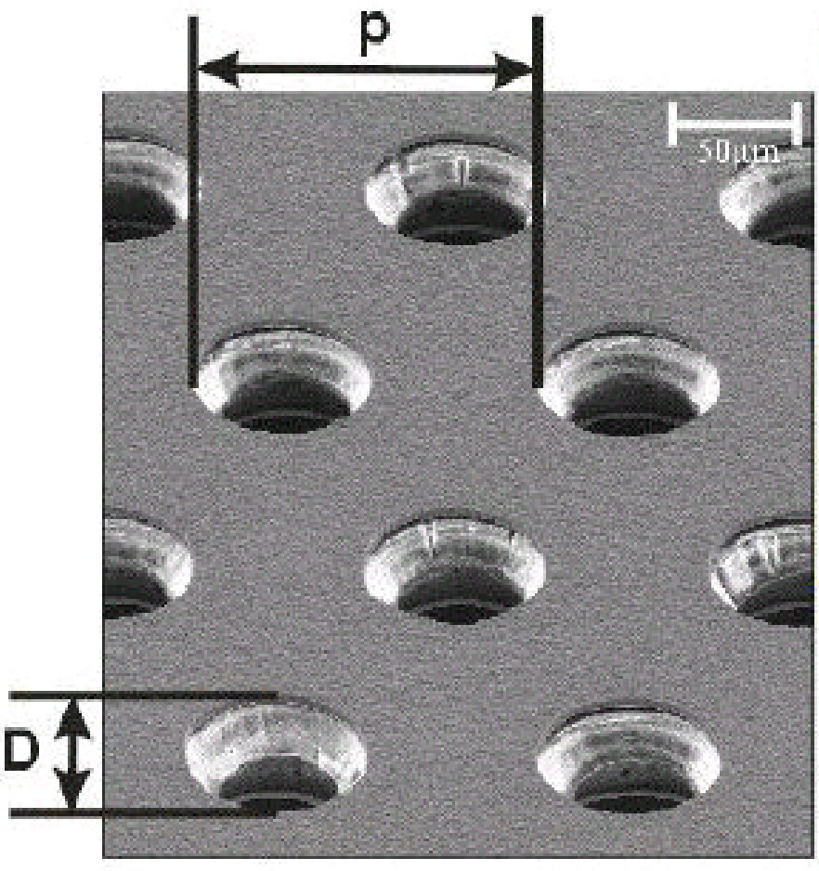
What is a GEM?
A Gas Electron Multiplier (GEM) is essentially a thin layer of kapton insulation sandwiched between two layers of copper.
Holes are then etched into the assembly.
A Gas Electron Multiplier (GEM) is essentially a thin layer of kapton insulation sandwiched between two layers of copper.
Holes are then etched into the assembly.
Many holes
A close-up of a single hole

Slide 33
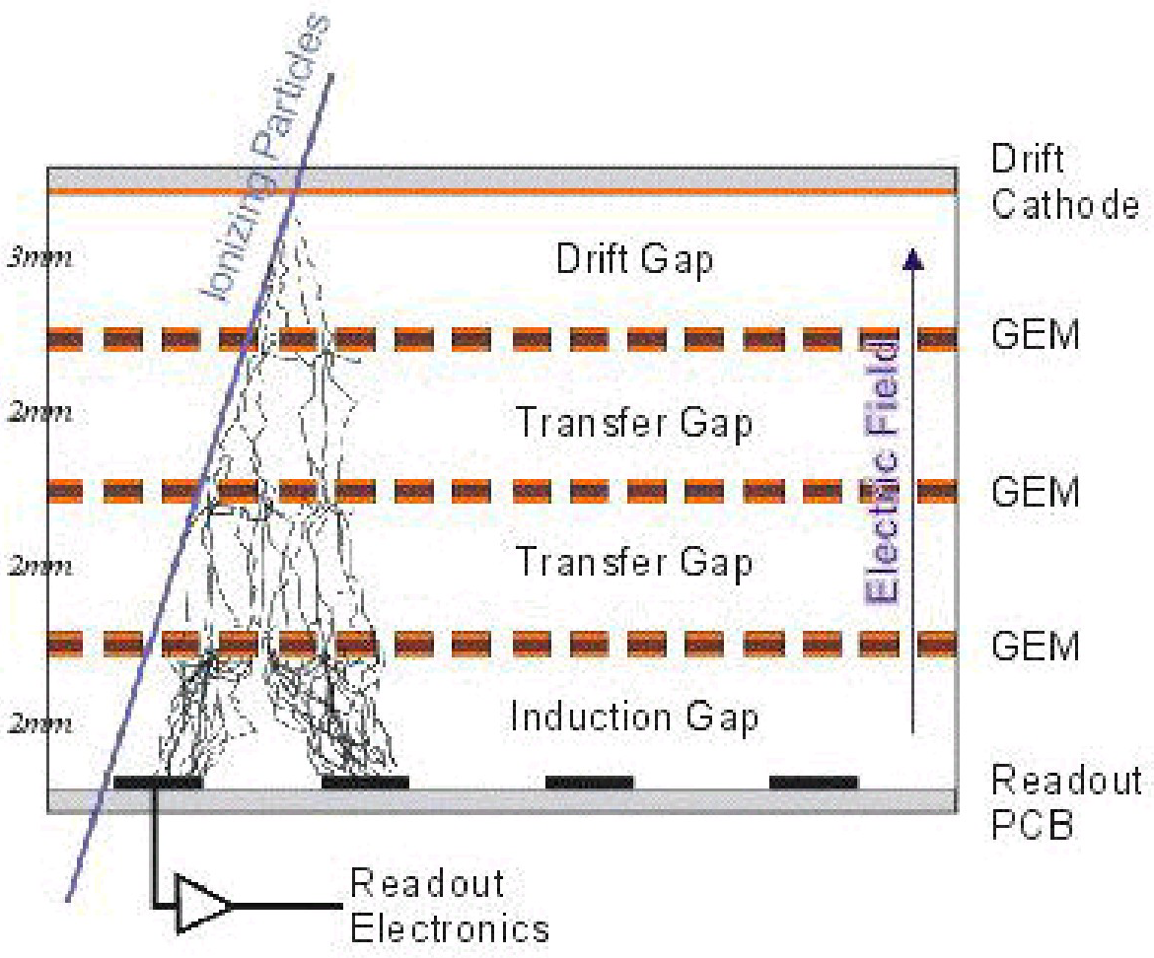
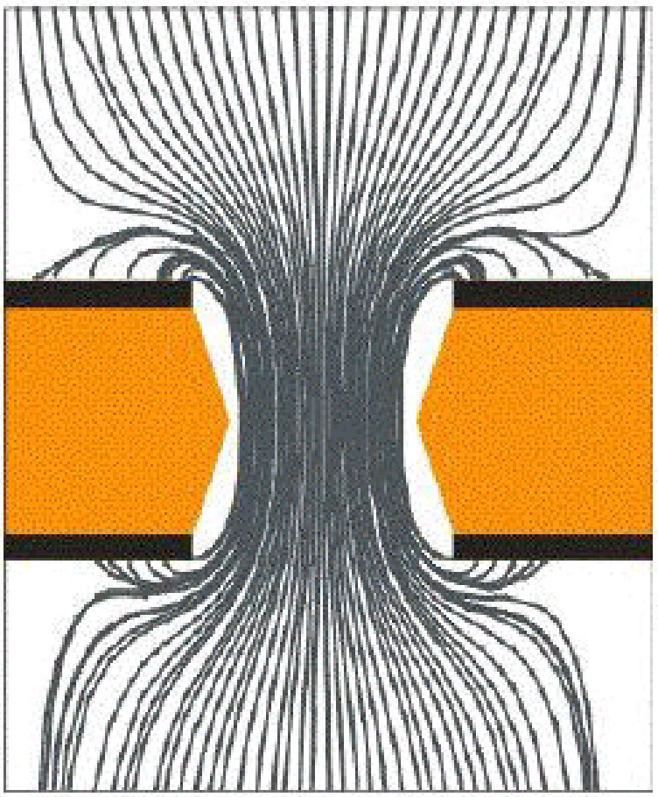
How does it work?
Behaves like a parallel plate capacitor.
e⁻ channeled through holes
Fields in holes can reach ~120 kV/cm.
Charge multiplication inside the holes only.
GEMs can be stacked so multiplication can be done in stages

Slide 34

Additional Material
The two textbooks
http://lhcb-muon.web.cern.ch/lhcb-muon/documents/Sauli_77-09.pdf
http://www.sciencedirect.com/science/article/pii/S0370157304003345#

Slide 36


Consequences of E-loss statistics
CONSEQUENCES OF ENERGY LOSS STATISTICS
LANDAU DISTRIBUTION OF ENERGY LOSS:
Counts
PARTICLE IDENTIFICATION
Requires statistical analysis of hundreds of samples
6000
4 cm Ar-CH4 (95-5)
5 bars
N = 460 i.p.
Counts
15 GeV/c
4000
6000
protons
electrons
FWHM~250 i.p.
2000
4000
0
0
500
1000
2000
N (i.p.)
For a Gaussian distribution:
σ_{N} ~ 21 i.p.
FWHM ~ 50 i.p.
0
0
500
1000
Slide courtesy of F. Sauli IEEE-NSS 2002
N (i.p)
I. Lehraus et al, Phys. Scripta 23(1981)727

